Slide 1

Application of Data Science to aid formulation of Skincare Products
BY:- FARKHANDA DALAL 31418
MANSI JANGLE 31438
MISBAH BAGWAN 31455
SEMINAR GUIDE:- PROF . RUTUJA KULKARNI

Slide 2
CONTENT
PROBLEM DEFINITION
INTRODUCTION
MOTIVATION
LITERATURE SURVEY
BLOCK DIAGRAM OF MODEL
ALGORITHM TAKEN TO IMPLEMENT SKINCARE REACTION PREDICITON
IMPLEMENTATION
FUTURE ENHANCEMENT
CONCLUSION
REFERENCES
Q&A

Slide 3
PROBLEM DEFINITION
The primary challenge in developing skincare formulations lies in the limited scope of existing studies, which have predominantly focused on Caucasian skin types. This has led to gaps in product efficacy for individuals with diverse skin tones, textures, and conditions.
The current goal is to use data science to bridge this gap by leveraging data analysis, classification using Machine Algorithms like Random Forest Classifier, Naïve- Bayes and Support Vector Machine to predict reactions that are likely to occur when various ingredients in different concentrations are applied on different skin type and varying melanin concentrations.

Slide 4
INTRODUCTION
Historically, product development has relied on limited datasets, often focused on Caucasian skin, resulting in ineffective, one-size-fits-all solutions.
Small sample sizes, subjective assessments, and outdated methodologies have further hindered the creation of inclusive products.
Our research addresses these gaps by applying data analysis techniques to analyze diverse skin datasets, considering like melanin content, age, hydration level ,epidermal thickness and skin type. factors
By leveraging machine learning and predictive analytics, we aim to develop personalized skincare formulations tailored to a wider audience, enhancing product efficacy and consumer satisfaction across all skin types.

Slide 5
MOTIVATION
Developing effective skincare products for diverse skin types has always been a challenge because of variations in skin composition, tone, and condition. Historically, skincare research has focused on Caucasian skin, resulting in a gap in product efficacy for individuals with darker skin tones or other skin concerns.
The motivation for this research lies in addressing these gaps by leveraging data science techniques and machine learning to better understand and cater to the needs of all skin types, especially for those with different ethnicity and skin colour.
With advancements in data collection, processing, and machine learning, it is now possible to analyse skin-related data in ways that were previously inaccessible. By combining data science with dermatological research, we can enhance product formulation processes, leading to better outcomes for consumers across all demographics.

Slide 6
LITERATURE SURVEY
Difference in Skin Structure :
Difference in Reaction :
Property | Caucasian | Brown | Black
Melanosomes | Small, approx. (0.5nm * 0.3 nm) [4] | Larger, approx. (0.6nm * 0.3 nm) [4] | Largest, approx. (1.0nm * 0.5 nm) [4]
Higher Melanin Concentration is seen at | Chin and Neck [3] | Neck and Periauricular space [3] | Fore Head and Chin [3]
Dermis | Thinner, between 1mm to 2mm | Intermediate, between 1mm to 3mm | Thicker, between 1.5mm to 4mm
Aging Results In | Photodamage, Loss of Collagen [1] | Dyspigmentation [1] | Frequent xerosis, Hyperpigmentation [1]
Irritation Causes Following Reaction | Erythema | Erythema, Hyperpigmentation | Results in darkening of effected area instead of Erythema
Sebum Production | More on Fore Head, Periauricular space, Chin [3] | More on Fore Head, Periauricular space, Chin [3] | More on Fore Head, Periauricular space, Cheek [3]
Ingredient | White Skin | Brown Skin | Black Skin
Retinol | Usually well tolerated, might cause Irritation, dryness | Mild irritation, causes hyperpigmentation if overused | Often causes irritation, high chance of hyperpigmentation
Niacinamide | Redness reduction | Balances oil, spots fade | Even tone, spots reduction
Glycolic | Gently exfoliates | Exfoliates well, higher risk of dark spots post-inflammation | Can cause excessive dryness and dark spots if not used carefully
Biasness towards non-Caucasian Skin in AI and ML in industry:
Bias | Meaning
Sampling Bias | Overrepresentation of light skin in datasets
Confounding Bias | Ignores melanin in predicting UV effects
Measurement Bias | Variability in skin measurements across devices
Label Bias | Numerical values don’t reflect individual skin differences

Slide 7
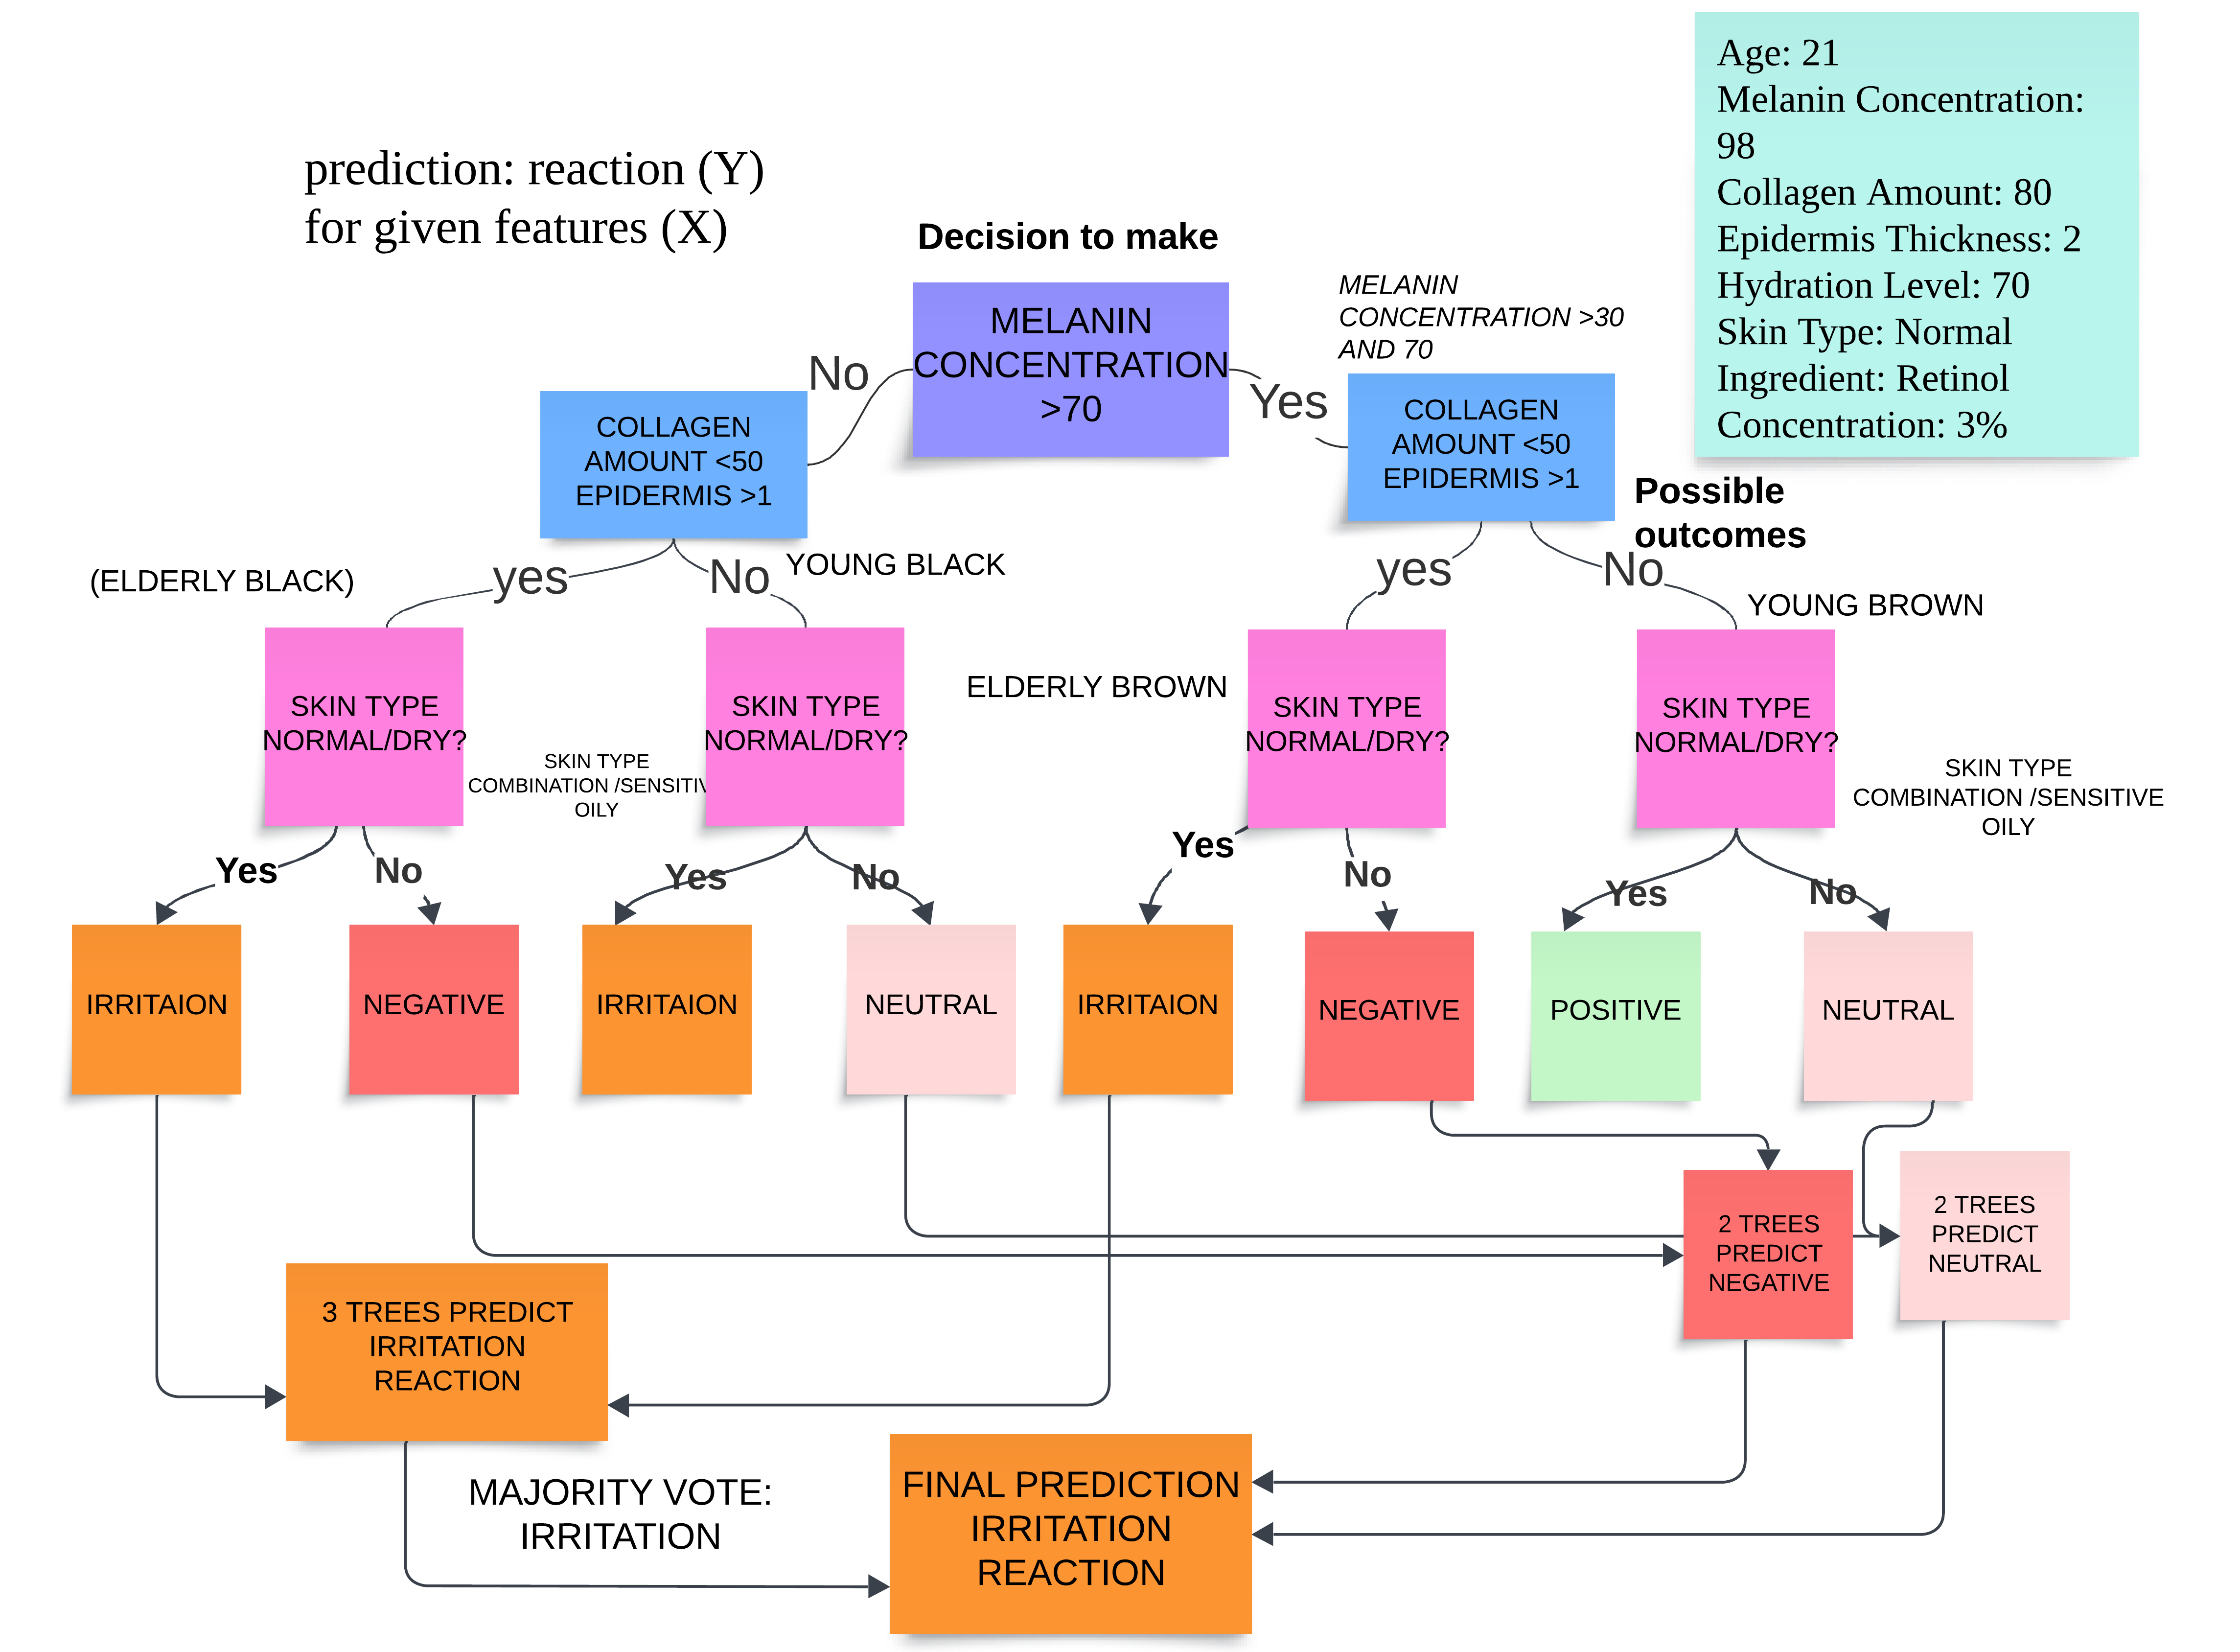
BLOCK DIAGRAM

Slide 8
ALGORITHM TAKEN TO IMPLEMENT SKINCARE REACTION PREDICITON
1. Data Preprocessing
Data Cleaning: Handling missing values, removing duplicates, ensuring data consistency
Feature Selection: Using relevant features such as Age, Melanin Concentration, Collagen Amount, etc.
One-Hot Encoding: Converting categorical features like Skin Type & Ingredient into numerical form
Train-Test Split: Splitting the dataset into training and testing sets (typically 80/20) to ensure balanced class distribution.
2. Training the Random Forest Classifier
Create a Forest: building multiple decision trees (estimators). Each tree is trained on a random subset of the training data
Each Tree’s Decision: Every tree predicts a possible outcome (skin reaction like neutral, positive, irritation, etc.) based on input features.
Aggregating Predictions: The forest collects votes from all the trees and uses a majority vote to predict the final skin reaction.
3.Employing Naïve-Bayes and SVM Model to contrast and compare accuracy of predictions
4. Prediction Process
Input User Data: Collecting inputs such as age, skin type, ingredient, and concentration.
Model Prediction: Passing the encoded data into the Random Forest model, which aggregates predictions from all its decision trees to predict the most likely skin reaction.
5. Model Evaluation
Confusion Matrix: Evaluating model accuracy by comparing predicted and actual reactions..
Classification Report: Measures model performance using precision, recall, and F1-score.

Slide 9
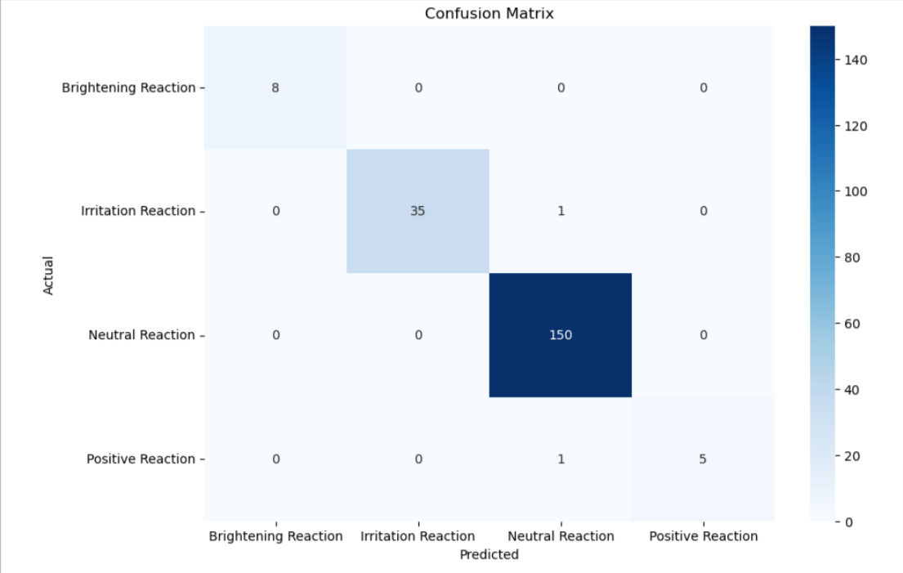
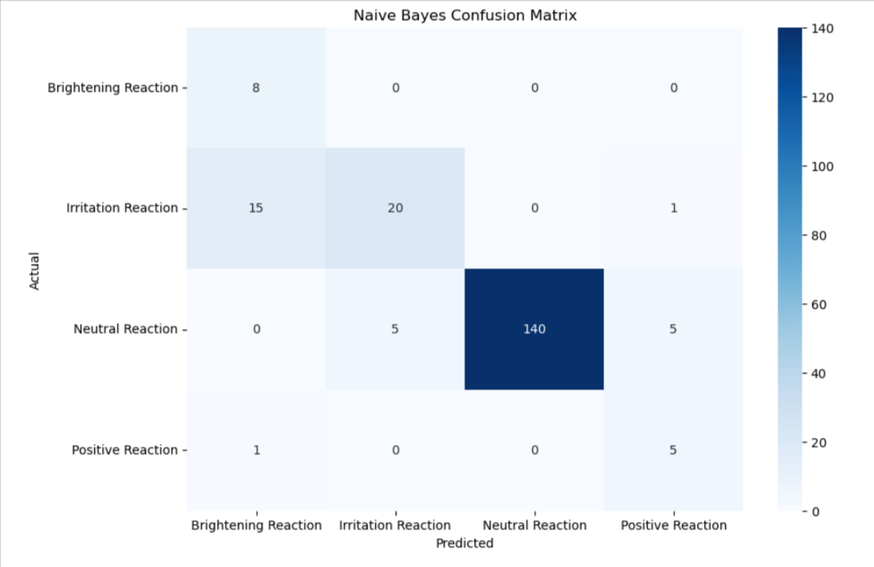
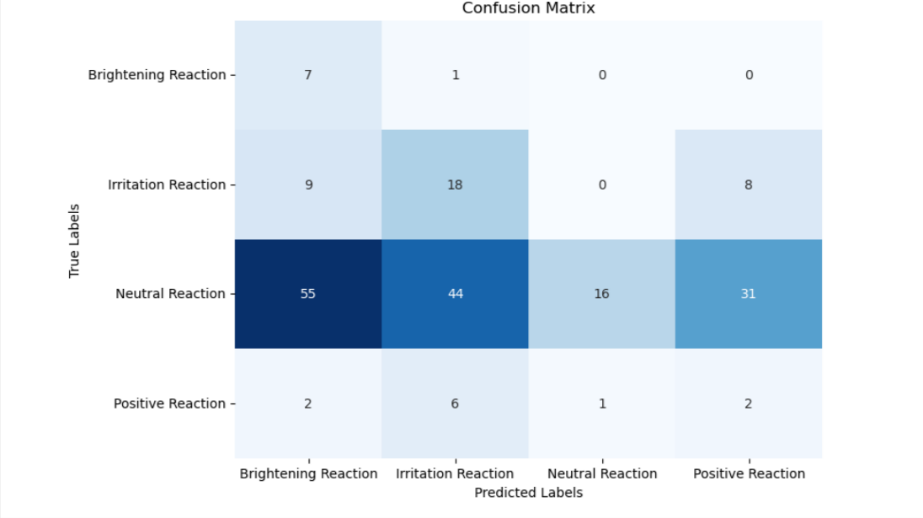
COMPARISON OF ALGORITHMS
RFC
Naïve Bayes
SVM

Slide 10
FUTURE ENHANCEMENT
Expanding Datasets: Gather diverse skin data globally for inclusive skincare solutions.
Inclusivity: Brands should cater to different skin types, considering factors like melanin and elasticity.
Ethical Concerns: Ensure ethical data collection, transparency, and user privacy.
Machine Learning: Future potential for enhancing predictive capabilities in skincare formulations.
Clustering Techniques: Use K-means or hierarchical clustering to uncover ingredient efficacy insights.

Slide 11
CONCLUSION
We can understand the right types of ingredients and their correct concentration to be used for skin of color.
We can understand how to formulate more products with more efficacy by tailoring formulations to have the appropriate ingredient concentrations.
By leveraging the power of Data Science, we can reduce the adverse ill-effects ingredients on non-Caucasian Skin.
The use of data science in skincare formulation offers immense potential to create more inclusive and effective products.

Slide 12
REFERENCES
A. Georgievskaya, T. Tlyachev, D. Danko, K. Chekanov, and H. Corstjens, "How artificial intelligence adopts human biases: The case of cosmetic skincare industry", AI and Ethics, vol. 4, no. 2, pp. 85-95, 2023
B. Lokesh, A. Devarakonda, G. Srinivas, and N. K. Naik, "Intelligent facial skin care recommendation system”, Afr. J. Bio. Sci., vol. 6, no. Si2, pp. 1822-1830, 2024.
C. D. Kaur and S. Saraf, "Skin care assessment on the basis of skin hydration, melanin, erythema, and sebum at various body sites", Asian Journal of Pharmaceutical and Clinical Research, vol. 4, no. 2, pp. 40-45, 2011.
Dr. Shahana Tanveer, Sama Khatoon, H. U. Begum, and U. Zainab, “Korean Skin Care Recommendation System”, International Journal of Information Technology and Computer Engineering, vol. 12, no. 2, pp. 797, ISSN 2347–3657, 2024.
E. Markiewicz and O. C. Idowu, "Personalized skincare: from molecular basis to clinical and commercial applications", 2018.
Fadly, D. Marlina, T. B. Kurniawan, M. Z. Zakaria, and S. F. Abdullah, "Sentiment analysis on natural skincare products", Journal of Data Science, vol. 12, pp. 1-17, 2022, ISSN 2805-5160, 2022.
FITZPATRICK, T.B., “The Validity and Practicality of Sun Reactive Skin Types I Through VI.”, Archives of Dermatology, 124: 869-871, 1988.
GRIMES, P.E., “Skin and Hair Cosmetic Issues in Women of Color.”, Dermatological Clinics, 18(4), Oct: 659-665, 2000
Jinhee Lee, Huisu Yoon, Semin Kim, Chanhyeok Lee, Jongha Lee, Sangwook Yoo, “Deep learning-based skin care product recommendation: A focus on cosmetic ingredient analysis and facial skin conditions”, Journal of Cosmetic Dermatology, vol. 23, no. 6, pp. 2066-2077, 2024.
L. J. Teixeira, "Specific cosmetic and skincare needs of women of color in South Africa", South African Journal of Dermatology, vol. 12, no. 1, pp. 60-72, 2006.

Slide 13
Q&A
With this we conclude our presentation and invite questions from your end

